Slide 1
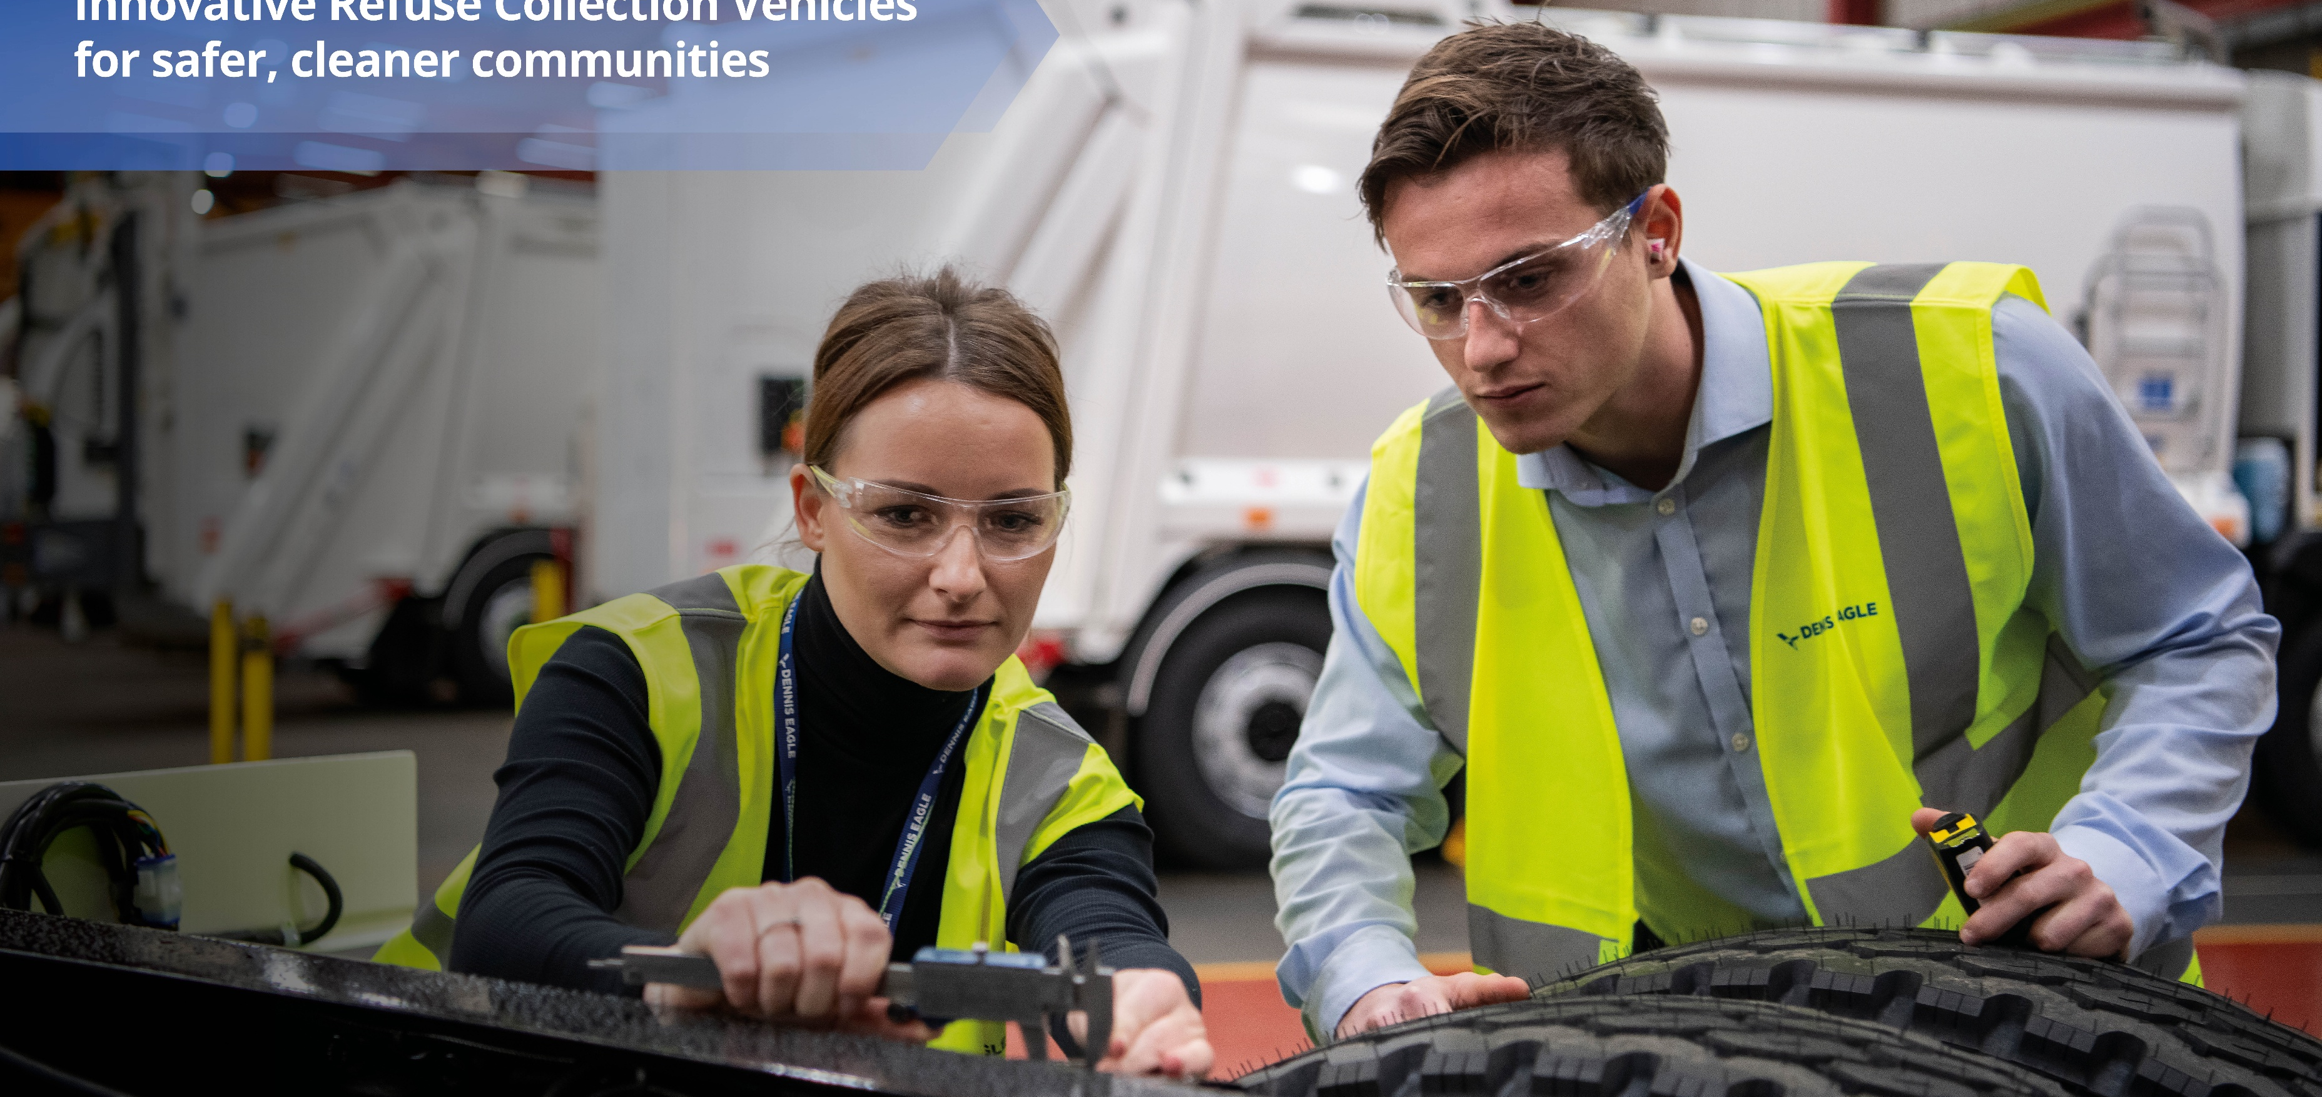
Career Pathways
Notes:
--- Welcome to the onboarding presentation for Alicia Bagga. This session will guide you through the essential aspects of the sales office operations, including processes, roles, systems, and continuous development to ensure a smooth integration and success in your role.

Slide 2
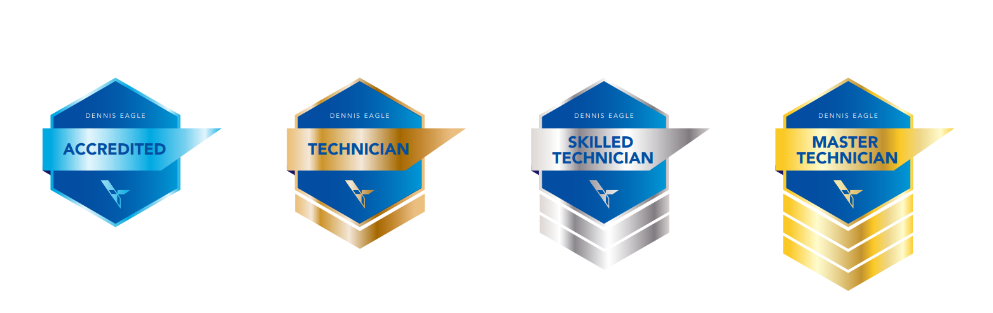
TRAINING COURSES
Career Pathway Process
Accredited
Delegate has taken the relevant fundamental courses to start building status in programme
Skilled Technician
Delegate transitions to Skilled Technician when they have gained product line competence with 3 product lines
Master Technician
Master Technician status is awarded when an Engineer gains competence in all courses available within a specific product range

Slide 3
TRAINING COURSES
Accredited Technician – Example
Example pathway to become an accredited Dennis Eagle Technician
Accredited
Chassis
Body
Bin Lift
Electrical Principles
Hydraulic Principles
Optional:
eCollect – Level 2
Elite EV – Level 2
Elite 6
Elite+
Engine strip and re-build
eCollect – Level 3
Elite EV – Level 3
Olympus Mini & Midi
Olympus
Olympus Twin Pack
Olympus Duo & One Pass
Front End Loader
Orus
Kerbloader
Toploader/ABTL
PBUV
OmniDEL & OmniDELe
OmniDEKA & OmniDEKAe
OmniTRADE / EuroTrade
Beta
Weighing

Slide 4
TRAINING COURSES
Skilled Technician – Example
Example pathway to become a recognised Elite 6, Olympus, Beta skilled Technician
Accredited
Chassis
Body
Bin Lift
Electrical Principles
Hydraulic Principles
Optional:
eCollect – Level 2
Elite EV – Level 2
Elite 6
Elite+
Engine strip and re-build
eCollect – Level 3
Elite EV – Level 3
Olympus Mini & Midi
Olympus
Olympus Twin Pack
Olympus Duo & One Pass
Front End Loader
Orus
Kerbloader
Toploader/ABTL
PBUV
OmniDEL & OmniDELe
OmniDEKA & OmniDEKAe
OmniTRADE / EuroTrade
Beta
Weighing

Slide 5
TRAINING COURSES
Master Technician – Example
Example pathway to become a recognised BinLift Master Technician
Accredited
Chassis
Body
Bin Lift
Electrical Principles
Hydraulic Principles
Optional:
eCollect – Level 2
Elite EV – Level 2
Elite 6
Elite+
Engine strip and re-build
eCollect – Level 3
Elite EV – Level 3
Olympus Mini & Midi
Olympus
Olympus Twin Pack
Olympus Duo & One Pass
Front End Loader
Orus
Kerbloader
Toploader/ABTL
PBUV
OmniDEL & OmniDELe
OmniDEKA & OmniDEKAe
OmniTRADE / EuroTrade
Beta
Weighing

